Slide 1
Theories of Motivation
Sessions(28-29)

Slide 2
Skinner’s Reinforcement theory of motivation
Reinforcement theory of motivation was proposed by B.F. Skinner and his associates.
Reinforcement is defined as anything that increases the strength of the response and also induces repetitions of the behavior that preceded the reinforcement.
Rewards are used to reinforce the behavior you want and punishments are used to prevent the behavior you do not want. Extinction is a means to stop someone from performing a learned behavior.

Slide 3
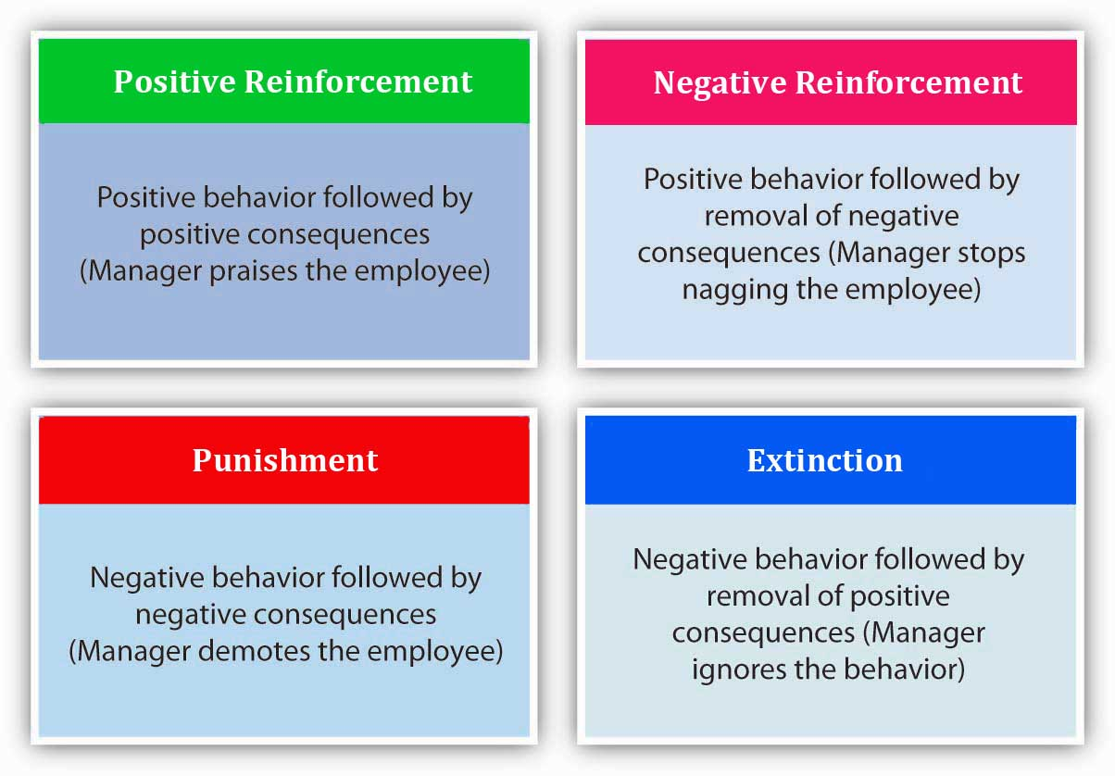

Slide 4
Positive Reinforcement:
Positive reinforcement is anything that strengthens and increases behavior by the presentation of desirable consequences. In other words, following a behavior by something pleasant is positive reinforcement. For example, giving a bonus for high productivity is positive reinforcement.

Slide 5
Negative reinforcement:
Negative reinforcement is anything that strengthens and increases behavior by the withdrawal or removal of unpleasant consequences. For example consider an organization that puts a ban on recreational activities of employees during working hours (such as not allowing them to read or check emails) due to low productivity. When productivity improves, the organization may lift the ban and allow recreational activities in a limited form. The lifting of the ban is negative reinforcement.

Slide 6
Punishment:
Punishment is the act of causing an unpleasant consequence to a response to prevent the person from repeating that behavior. Placing an employee on suspension for excessive absenteeism is an example of punishment. Punishment is not the same as negative reinforcement. Negative reinforcement strengthens and increases behavior while punishment seeks to weaken and decrease behavior

Slide 7
Extinction:
Eliminating any reinforcement that is maintaining a behavior is called extinction. For instance an organization may announce that it wants to adopt an open door policy to encourage employees to express their opinions to the management. However the managers may not be responsive to employees who approach them to discuss problems. This lack of responsiveness causes employees to stop coming up to the managers over time.

Slide 8
McClelland’s Need Theory
Psychologist David McClelland advocated Need theory, also popular as Three Needs Theory.
This motivational theory states that the needs for achievement, power, and affiliation significantly influence the behavior of an individual, which is useful to understand from a managerial context.

Slide 9
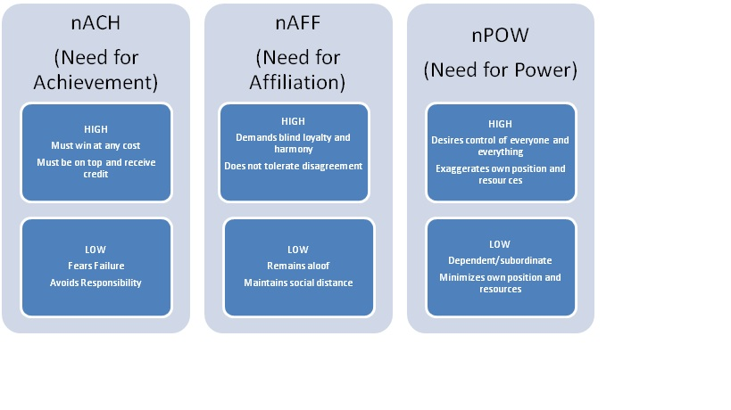

Slide 10
The Porter and Lawler Motivation model
Porter and Lawler (Lyman W Porter and Edward E Lawler) used Victor Vroom’s Expectancy Theory as a foundation to develop their expectancy model. Similar to Vroom’s theory Porter and Lawler concluded that an individual’s motivation to complete a task is affected by the reward they expect to receive for completing the task.
However Porter and Lawler introduced additional aspects to the expectancy theory as they felt that Vroom's theory was too simple.

Slide 11
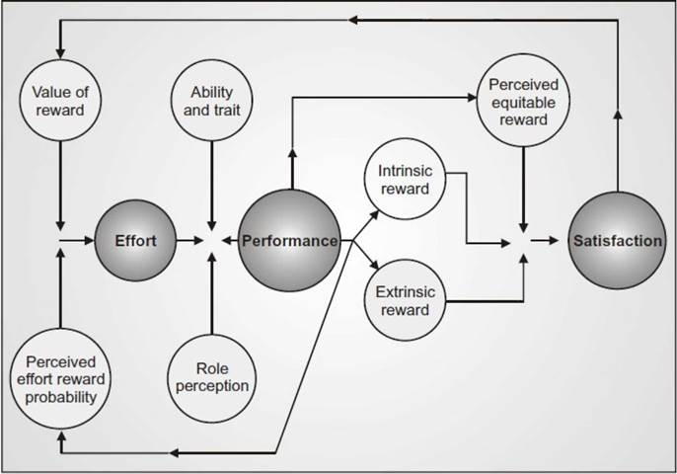

Slide 12
Equity theory
The Equity theory owes its origin to several prominent theorists. However, it is J. Stacey Adam’s formulation of the theory which is most highly developed and researched statement on the topic.
According to Adams, equity theory is based on the simple assumption that people want to be treated fairly. Many employees are concerned not only with satisfying their own needs but also compare what others receive.

Slide 13
